Slide 1
Microprocessor System Design
Omid Fatemi
(omid@fatemi.net)

Slide 2
Outline
Objectives
Administration
Digital System Design
Microprocessors - History
Structure, Registers
Assembly language, Programming

Slide 3
Objectives
Basic understanding of the operation of microprocessors.
Assembly language for control and interfacing applications
Basic Techniques for using microprocessors.
Intel 80x86 family
Microcontrollers and embedded design
AVR, 8051 , PIC, ARM based microcontrollers
Interfacing
Embedded and real-time system design

Slide 4
Administration
Text book:
The 80x86 IBM PC and Compatible Computers (Vol. 1 and 2)
ARM
AVR Microcontroller and Embedded Systems
Instructor: Omid Fatemi (omid@fatemi.net)
Office: new building, room 608
Office Hours: Sat. 11:00 – 12:00 or by appt.
Web: http://mec.ut.ac.ir/course/view.php?id=17449
Course: ریز پردازنده 1 3961810120701
شماره دانشجویی خود به عنوان نام کاربری و کد ملی به عنوان گذرواژه
دانشجویانی که از ترم گذشته در سامانه ثبت بوده اند باید با همان نام کاربری و گذرواژه قبلی وارد سامانه شوند.
دانشجویانی که مشخصات آنها از قبیل شماره تماس و کدپستی در گلستان کامل نباشد در سامانه آموزش الکترونیکی ثبت نخواهند شد.
راهنما: http://utec.ut.ac.ir/web/offering/166

Slide 5
Administration (2)
Class is flipped
Lectures: out of class
Fast review in class
Class work:
In group.
Discussion is allowed
Writing should be own work.
Quiz:
Closed book, no discussion and talking.
Copying, looking at other’s work is not allowed
Everything is in site.
Next session:
Because of watching video and assignment: Monday

Slide 6
Grading
Class is flipped
5% Video watching (how to assess? Closed quiz, class work and quiz)
15% lab work (bring your laptops. Possible?)
Projects (5) – 25% (bonus: 10%)
PCB should be designed
written report
55% Final Exam and Mid-term
5% bonus for class material
Notes:
give poster session

Slide 7
Digital System Design Applications
Signal processing
Control systems
Communications
Micro-computers
Robotics
Multimedia
Internet , Distance learning

Slide 8
Solutions
LSI chips
PCB, 74 series
VLSI design (ASIC)
Standard cells
Gate arrays
FPGA
Embedded micro controllers, Real-time Operating systems
General purpose processors
Special purpose processors
System on a chip (SoC)
Hardware, Firmware and Software

Slide 9
Microprocessor Based
More reliable
Less expensive
Easier to debug
Easier to maintain
Easier to upgrade
Disadvantage:
Speed
Less flexible in terms of signals
More power consumption

Slide 10
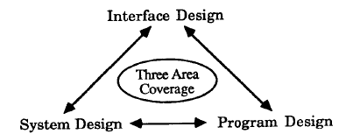
Design Process
Hardware, Firmware and Software

Slide 11
Design Process Steps
Define requirements
Develop specifications
Preliminary design
Intermediate design
Detailed design
Implementation
Verification and acceptance

Slide 12
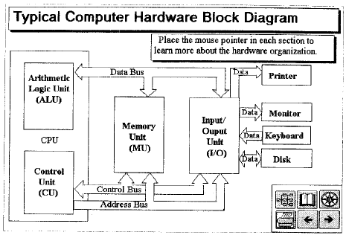
Microprocessors
They accept programs

Slide 13
History
1940: vacuum tubes
ENIAC: 130000 watts, 150 square meter
1950: transistors
1959: first IC
1971: 4004 by Intel
4-bit, 2300 transistor
1970s: 8080/85, Z80, 6800, 6500
Appliances, computers
1980s: RISC
1990s: Embedded
2000s: Multi-cores

Slide 14
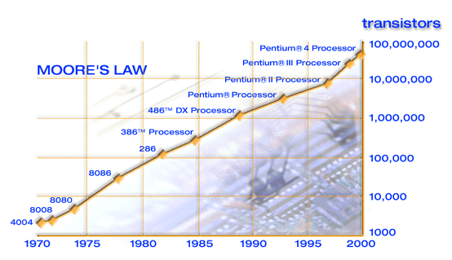
Intel’s Microprocessors and Moore’s law
Model
Year Introduced
Clock Rate
Transistors per chip
4004
1971
0.1 MHz
2,250
8008
1972 .
0.2 MHz
3,500
8080
1974 .
2 MHz
5,000
8086
1978 *
5 MHz
29,000
80286
1982 *
6 MHz
120,000
386™ processor
1985 **
16 MHz
275,000
486™ DX processor
1989 **
26 MHz
1,180,000
Pentium® processor
1993 ***
60 MHz
3,100,000
Pentium II processor
1997 ***
233 MHz
7,500,000
Pentium III processor
1999 ***
450 MHz
24,000,000
Pentium 4 processor
http://www.intel.com/pressroom/archive/backgrnd/30thann_funfacts.htm
2000 ***
1500 MHz
42,000,000
Notes:
Moore’s law in 1965 (transistors per integrated circuit would double every 18 months )
. = 8 bit bus; * = 16 bit bus; ** = 32 bit bus; *** = 32/64 bit bus
4004 was the 1st microprocessor; it had only a 4 bit bus.
8088 (the 8-bit sister of the 8086) at 5 Mhz powered the first IBM PCs.

Slide 15
From Intel Site
http://www.intel.com/pressroom/archive/backgrnd/30thann_funfacts.htm
Today, there are 40 microprocessors in the average middle-class American household. The number increases to 50 when a PC and all the surrounding paraphernalia are added.¹
These microprocessors are hidden in bathroom scales with digital readouts, irons with automatic shutdown switches and even the common electronic toothbrush that possesses some 3,000 lines of computer code.¹
Today's automobiles have, on average, more than 50 microprocessors controlling things such as air bags, brakes, engines, windows, door locks and cruise control.²
Developed during the 1970s, the microprocessor became most visible as the central processor of the personal computer. Microprocessors also play supporting roles within larger computers as smart controllers for graphics displays, storage devices, and high-speed printers. However, the vast majority of microprocessors are used to control a broad array of devices from consumer appliances and PC-enhanced toys to satellites orbiting the earth.³
The microprocessor has made possible the inexpensive hand-held electronic calculator, the digital wristwatch, and the electronic game. Microprocessors are used to control consumer electronic devices, such as the programmable microwave oven and videocassette recorder; to regulate gasoline consumption and antilock brakes in automobiles; and to monitor alarm systems.³
It all started 30 years ago, November 1971
Intel began development of the first microprocessor in 1969 as part of a project to design a set of chips for a family of programmable calculators from Japanese calculator manufacturer Busicom.
Originally, Busicom owned the rights to the microprocessor having paid Intel $60,000. Realizing the potential for the "brain" chip, Intel offered to return the $60,000 in exchange for the rights to the microprocessor design.
Busicom agreed and Intel introduced the 4004 to the worldwide market on November 15, 1971. The 4004 sold for $200 each. The key to the success of the microprocessor idea was to provide a software programmable device. Prior to the invention of the programmable microprocessor, chips were designed to perform specific "fixed" functions.
Today's state-of-the-art Pentium® 4 Processor
The latest direct descendant of the 4004 is the Intel® Pentium® 4 processor for desktop personal computers.
Today's cutting edge Pentium 4 microprocessor operates at 2 billion cycles per second.
It took 28 years to go from a speed of 108,000 cycles per second performance in the 4004 brain chip to1 billion cycles per second (1 gigahertz) with the Intel® Pentium® III processor - and only 18 months to break the 2 gigahertz barrier with the August announcement of the latest Pentium 4 microprocessor.
Pentium 4 processor-based personal computers (at price points ranging from under $1,000 to $2,000) are fueling the latest trends in home computing - from digital music and home digital movie making to photo-realistic 3D images and visual environments delivered on and off the net in advanced games, education and shopping experiences.

Slide 16
Numbering and Coding Systems
Decimal and binary systems
Converting
Hexadecimal and converting
Counting and addition
2’s complement and subtraction
ASCII code, Unicode, utf-8
Bit, Nibble, Byte, Word,

Slide 17
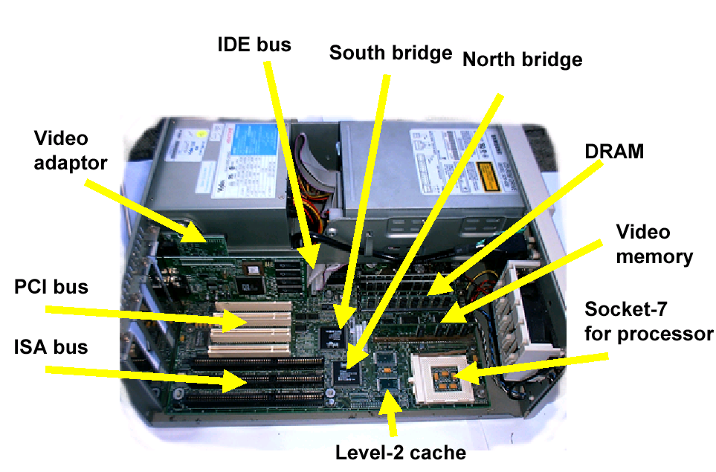
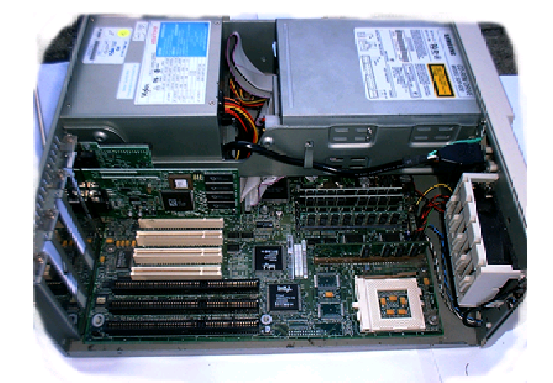
Computer modules
Address Bus
Keyboard
Monitor
Printer
Mouse
Microphone
Disk
CPU
Memory
(RAM, ROM)
Peripherals
(IO)
Data Bus
Control Bus
Notes:
Talk about the effects of the size of data bus - bidirectional
Size of address bus – number of locations and byte addressable - unidirectional

Slide 18
8086/8 Internal Organization
Processor Model
Address Bus
Data Bus
Addr generation
Bus Controller
BIU
AH
AL
ADD
BH
BL
CH
CL
1
EU
DH
DL
2
BP
CS
3
Instruction
Queue
DI
ES
4
SI
SS
5
SP
DS
6
IP
Internal Data Bus
ALU
FLAGS
Notes:
EU: Execution unit
BIU: bus interface unit

Slide 19
How does a CPU work?
Combinational or sequential?
Hybrid → sequential
Inputs to the state machine (sequential circuit)?
Clock
Program
What it does with a program?
Reads from memory, where?
Program counter, Instruction pointer (IP)
Understands it (decode), then?
Execute, then?
Next instruction

Slide 20
A Simple Program
Program:
Move value 21H into register AL
Add value 42H to register AL
Store AL in memory location 33D0H
Memory contents (instruction part)
1500 B0
1501 21
1502 04
1503 42
1504 35 (A2 in pentium)
1505 D0
1506 33
Execution?

Slide 21
Registers (Temporary Storage)
One or two bytes (in 8088)
8-bit register:
16-bit register:
Registers:
AX, BX, CX, DX
AH, AL, BH, BL, CH, CL, DH, DL
7
0
D7
D2
D1
D0
15
0
D15
D14
D2
D1
D0

Slide 22
Registers by Category
Category | Bits | Register Names
General | 16 | AX, BX, CX, DX
 | 8 | AH, AL, BH, BL, CH, CL, DH, DL
Pointer | 16 | SP (stack pointer), BP (base pointer)
Index | 16 | SI (source index), DI (destination index)
Segment | 16 | CS (code segment), DS (data segment), SS (stack segment), ES (extra segment)
Instruction | 16 | IP (instruction pointer)
Flag | 16 | FR (flag register)

Slide 23
Assembly Programming
CPU works in binary
All instructions, data are in binary
Binary instructions (0, 1) are Machine Language
Or even hexadecimal representation
Assembly language
Mnemonics
Low level
Assembler
Linker

Slide 24
Assembler versus Machine Code
ADD AX, BX ;AX gets value AX+BX
SUB AX, BX ;AX gets value AX-BX
AND AX, BX ;AX gets bitwise AND of AX and BX
INC AX ;AX gets its original value plus 1
DEC BX ;BX gets its original value minus 1
MOV AX, BX ;AX gets values in BX
93ee:db1e
93ee:db1f
93ee:db20
93ee:db21
93ee:db22
93ee:db23
93ee:db24
93ee:db25
93ee:db26
93ee:db27
01
D8
29
D8
21
D8
40
4B
8B
C3
a19fe
a19ff
a1a00
a1a01
a1a02
a1a03
a1a04
a1a05
a1a06
a1a07
ASSEMBLER
01 D8
29 D8
21 D8
40
4B
8B C3
01 D8
29 D8
21 D8
40
4B
8B C3
LINKER
LOADER
logical
address
physical
memory
physical
address

Slide 25
Summary
Digital System Design
Microprocessor based
Hardware, software and firmware
Microprocessors
History
Numbering systems
Internal Organization
Registers, segments
Assembly language

